Slide 1
Association Rules

Slide 2
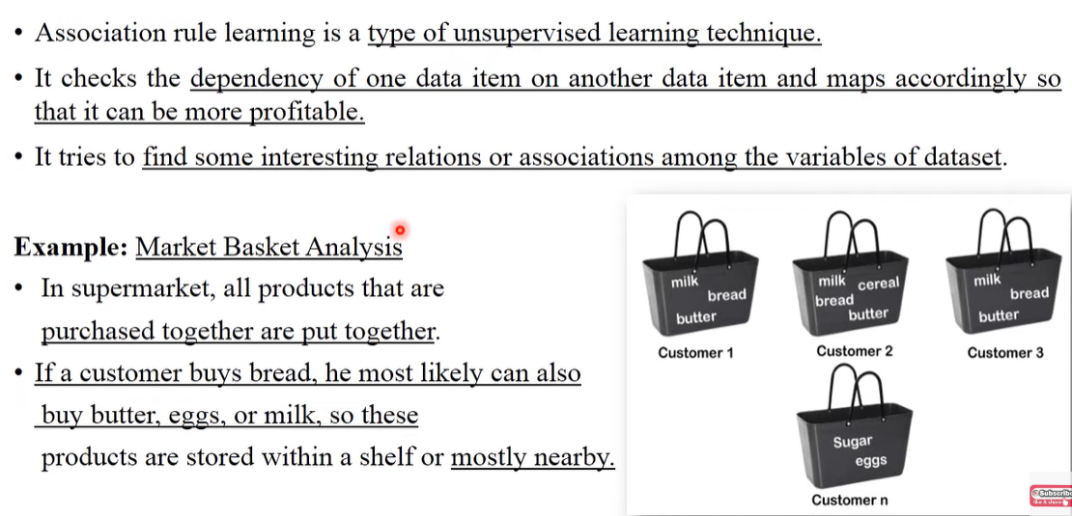

Slide 3
Market Basket Analysis
Think back to the last time you made an impulse purchase????
Maybe you were waiting in the grocery store checkout lane and bought a pack of chewing gum or a candy bar.
You might have even bought this book on a whim on a bookseller's recommendation.
These impulse buys are no coincidence, as retailers use sophisticated data analysis techniques to identify patterns that will drive retail behavior.

Slide 4
In years past, such recommendation systems were based on the subjective intuition of marketing professionals and inventory managers or buyers.
More recently, as barcode scanners, computerized inventory systems, and online shopping trends have built a wealth of transactional data, machine learning has been increasingly applied to learn purchasing patterns.
The practice is commonly known as market basket analysis due to the fact that it has been so frequently applied to supermarket data.

Slide 5
Association Rules
The building blocks of a market basket analysis are the items that may appear in any given transaction.
Groups of one or more items are surrounded by brackets to indicate that they form a set, or more specifically, an itemset that appears in the data with some regularity.
Notes:
Association Rules are widely used to analyze retail basket or transaction data, and are intended to identify strong rules discovered in transaction data using measures of interestingness

Slide 6
Transactions are specified in terms of item sets, such as the following transaction that might be found in a typical grocery store:

Slide 7
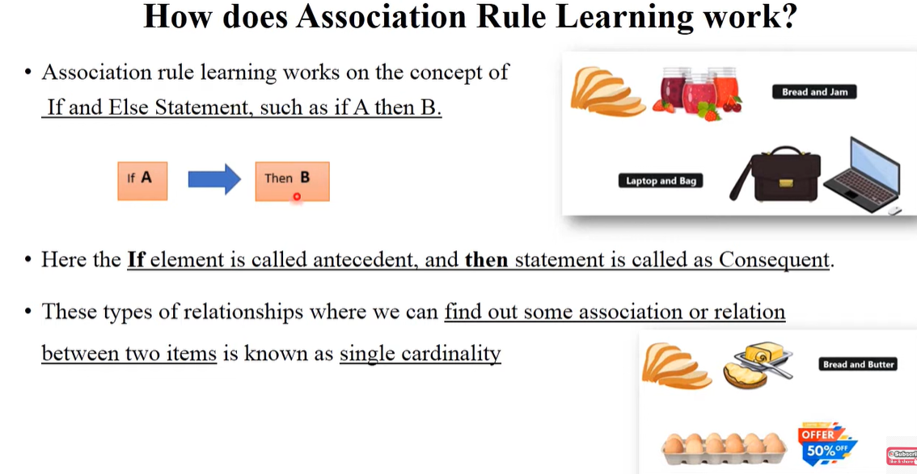

Slide 8
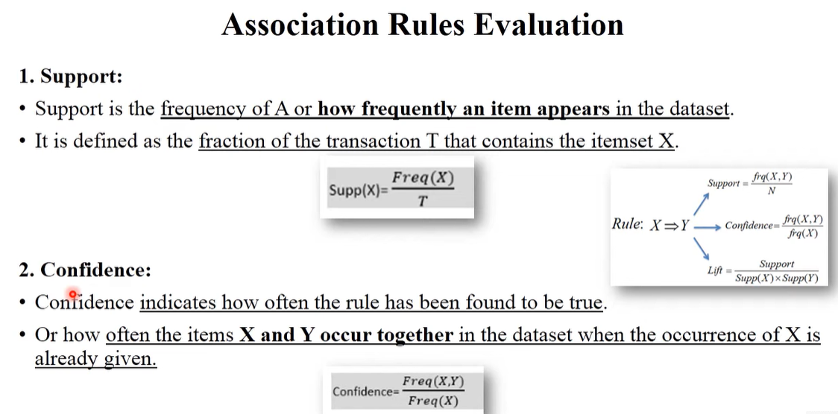
3. Lift:
It indicates the strength of any rule.
Lift =supp(x,y)/ supp(x).supp(y)
Lift=1 independent to each other
Lift>1 dependent on each other
Lift<1 one item is a substitute of other item

Slide 9
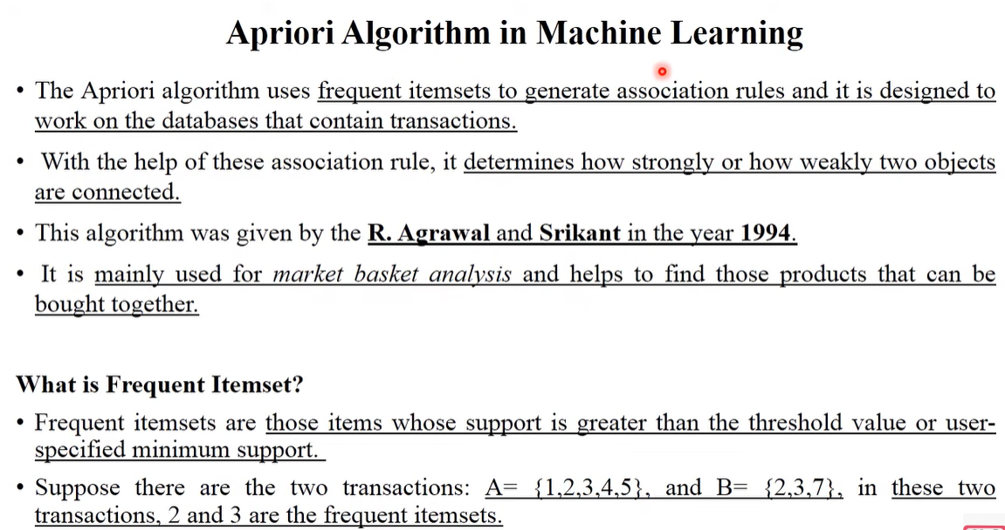

Slide 10
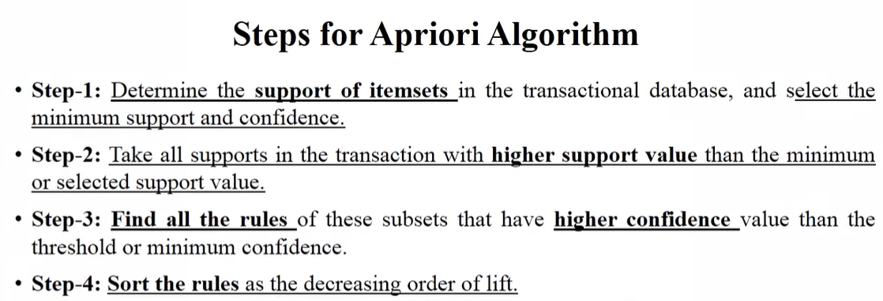

Slide 11
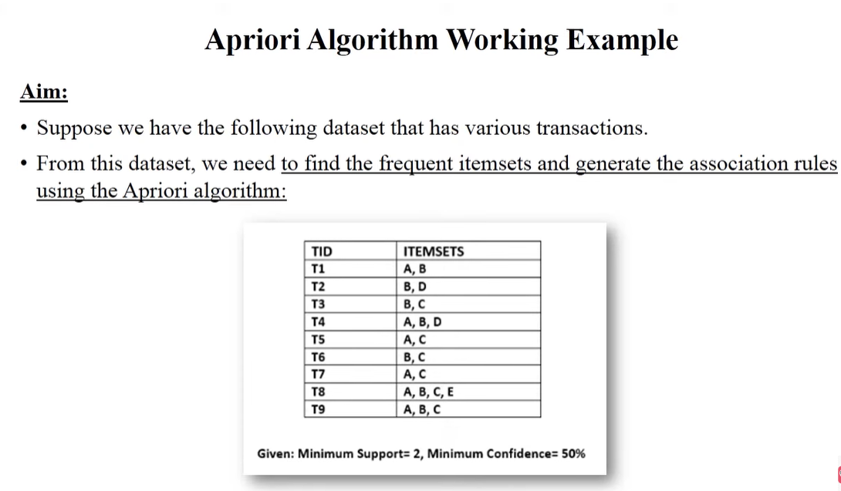

Slide 12
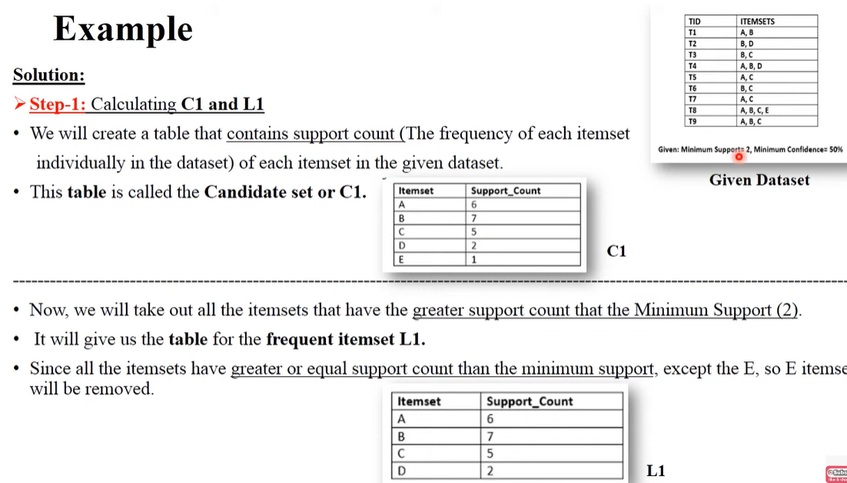

Slide 13
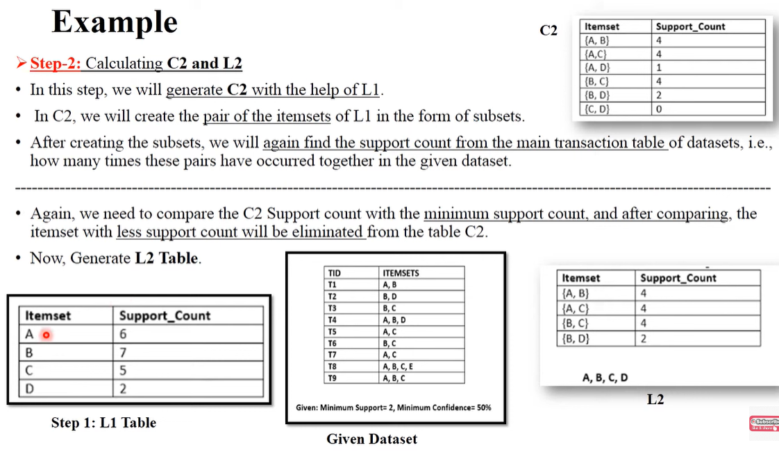

Slide 14
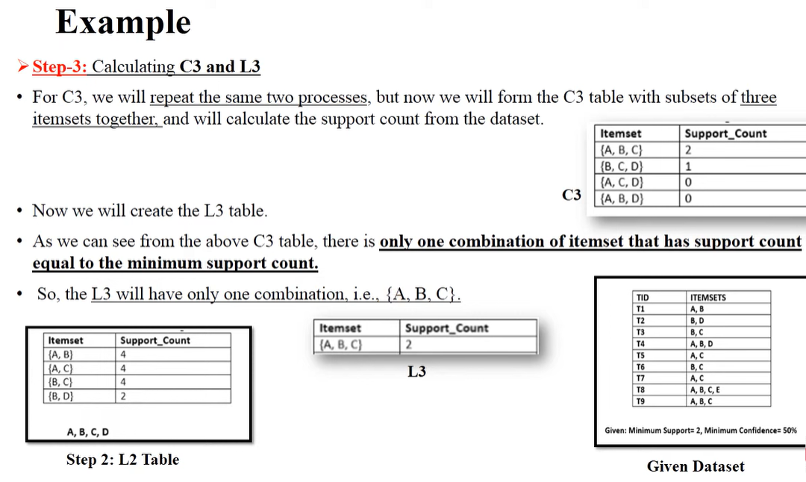
Item set | Support count
{A,B,C} | 2
{B,C,D} | 0
{A,C,D} | 0
{A,B,D} | 1

Slide 15
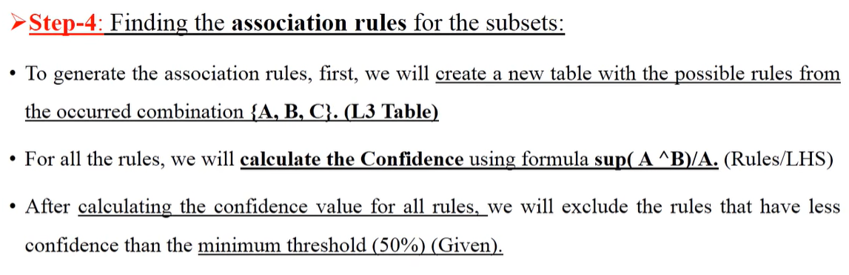

Slide 16
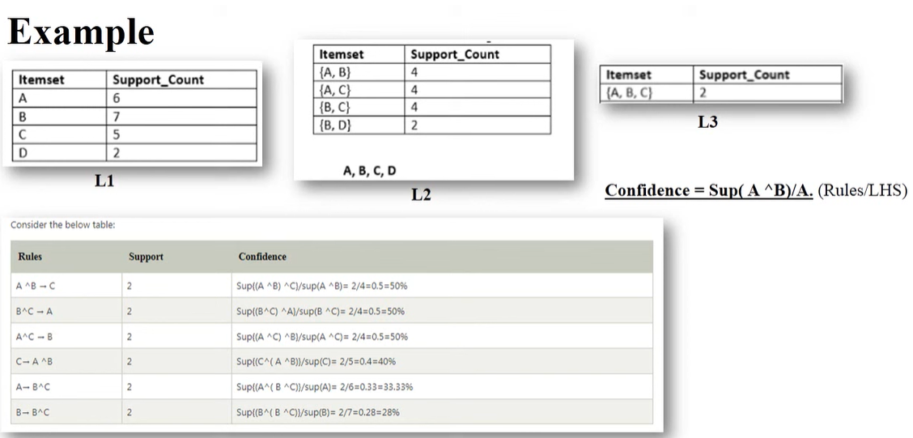

Slide 17
Association rules are always composed from subsets of item sets and are denoted by relating one item set on the left-hand side (LHS) of the rule to another itemset on the right-hand side (RHS) of the rule.

Slide 18
The LHS is the condition that needs to be met in order to trigger the rule, and the RHS is the expected result of meeting that condition.
A rule identified from the example transaction might be expressed in the form:

Slide 19
In plain language, this association rule states that if peanut butter and jelly are purchased together, then bread is also likely to be purchased. In other words, "peanut butter and jelly imply bread.“
Association rule learners are unsupervised, there is no need for the algorithm to be trained; data does not need to be labeled ahead of time. The program is simply unleashed on a dataset in the hope that interesting associations are found.

Slide 20
Applications of Association rules
Although association rules are most often used for market basket analysis, they are helpful for finding patterns in many different types of data. Other potential applications include:
Searching for interesting and frequently occurring patterns of DNA and protein sequences in cancer data

Slide 21
Finding patterns of purchases or medical claims that occur in combination with fraudulent credit card or insurance use
Identifying combinations of behavior that precede customers dropping their cellular phone service or upgrading their cable television package

